Slide 1

Author’s Purpose Practice

Slide 2

Let’s see how you do recognizing the author’s purpose for writing!

Slide 3
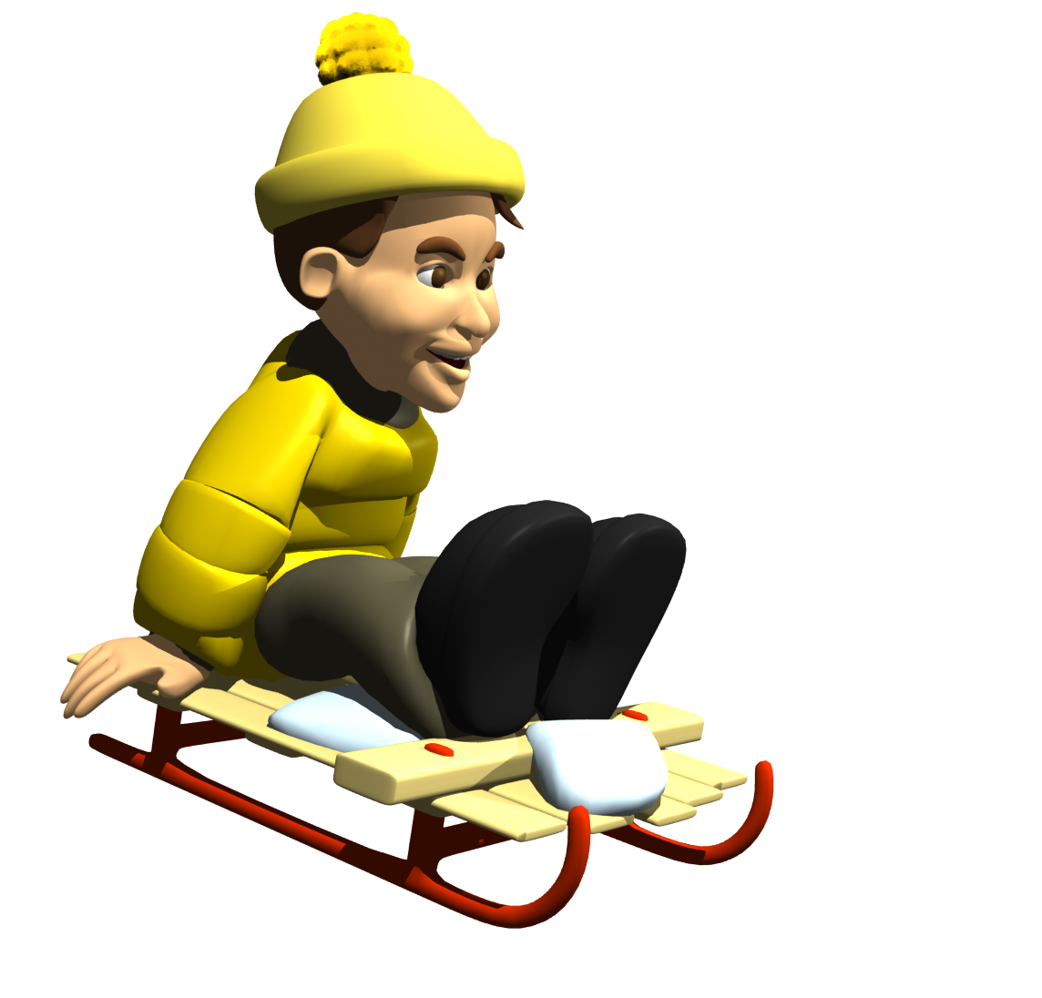
Author’s Purpose
Todd was in his basement. He was searching everywhere for his sled. Across town, Benny was in his attic. He was searching, too. It was time for one more of Todd and Benny’s contests. This time the winner would be the first to make sled tracks down the big hill. Todd planned to be first. So did Benny.
What is the author’s purpose for writing this?
Inform
Persuade
Entertain

Slide 4

Oh no!
Try again please!

Slide 5

Great job! You did it!

Slide 6
Author’s Purpose
Todd was in his basement. He was searching everywhere for his sled. Across town, Benny was in his attic. He was searching, too. It was time for one more of Todd and Benny’s contests. This time the winner would be the first to make sled tracks down the big hill. Todd planned to be first. So did Benny.
The author wants to __________.
describe a snowy day
explain how to use a sled
tell a story about a winter contest between two boys

Slide 7
Oh no!
Try again please!

Slide 8
Great job! You did it!

Slide 9

Author’s Purpose
Vote for Carl for class president! Carl is a leader! Last year in fourth grade, he was a great vice-president. This year he volunteers to help with after-school clubs. He will do great things for our class! Carl promises more school dances. And better choices at lunch. So vote for Carl for class president
What is the author’s purpose for writing this?
Inform
Persuade
Entertain

Slide 10
Oh no!
Try again please!

Slide 11
Great job! You did it!

Slide 12
Author’s Purpose
Vote for Carl for class president! Carl is a leader! Last year in fourth grade, he was a great vice-president. This year he volunteers to help with after-school clubs. He will do great things for our class! Carl promises more school dances. And better choices at lunch. So vote for Carl for class president
The author tried to persuade us to vote for Carl by telling about his ____.
Accomplishments and promises
Grades and behavior
Family and friends

Slide 13
Oh no!
Try again please!

Slide 14
Great job! You did it!

Slide 15
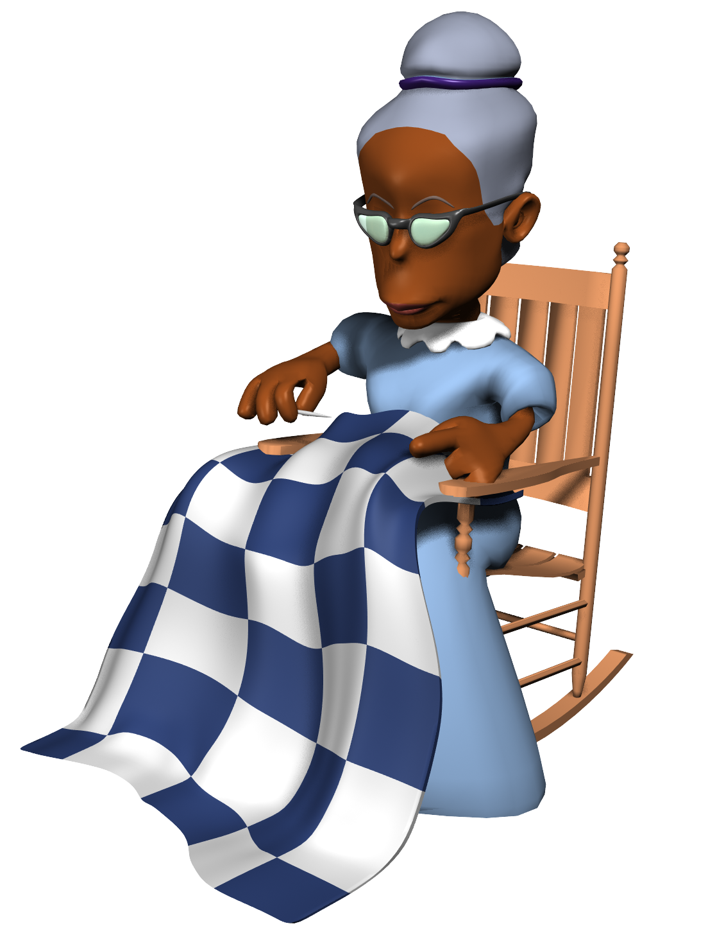
Author’s Purpose
First, turn up the hem and press it into place. Then turn under a small edge on the inside of the hem. Press that, too. Next, pin the hem in place. Then thread a needle. Sew the hem in place. Use longer stitches on the inside and smaller stitches on the outside. That way, the stitches will barely show
What is the author’s purpose for writing this?
Inform
Persuade
Entertain

Slide 16
Oh no!
Try again please!

Slide 17
Great job! You did it!

Slide 18
Author’s Purpose
First, turn up the hem and press it into place. Then turn under a small edge on the inside of the hem. Press that, too. Next, pin the hem in place. Then thread a needle. Sew the hem in place. Use longer stitches on the inside and smaller stitches on the outside. That way, the stitches will barely show
What happens after you pin the hem in place?
Use longer stitching on the inside
Thread a needle
Turn under a small edge on the inside of the hem

Slide 19
Oh no!
Try again please!

Slide 20
Great job! You did it!

Slide 21
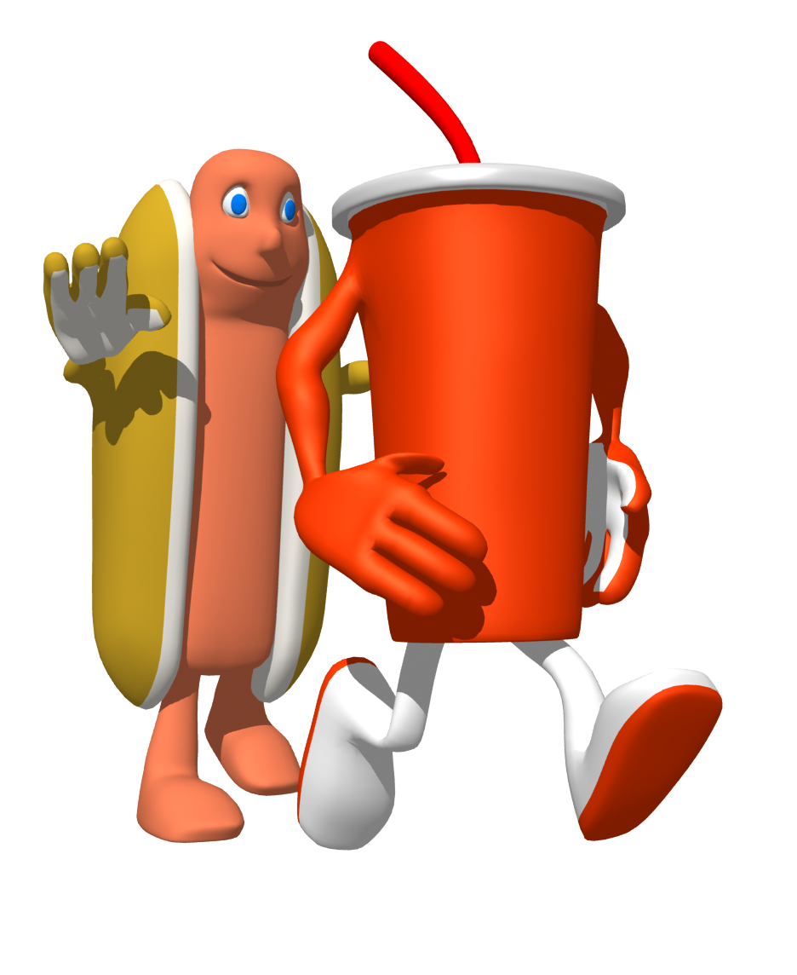
Author’s Purpose
It's New!
It's Refreshing!
It's Slurpy Soda!
This is the best soda in the world! If you drink this soda you will jump higher, run faster and be smarter in school. Try one today!
What is the author’s purpose for writing this?
Inform
Persuade
Entertain

Slide 22
Oh no!
Try again please!

Slide 23
Great job! You did it!

Slide 24
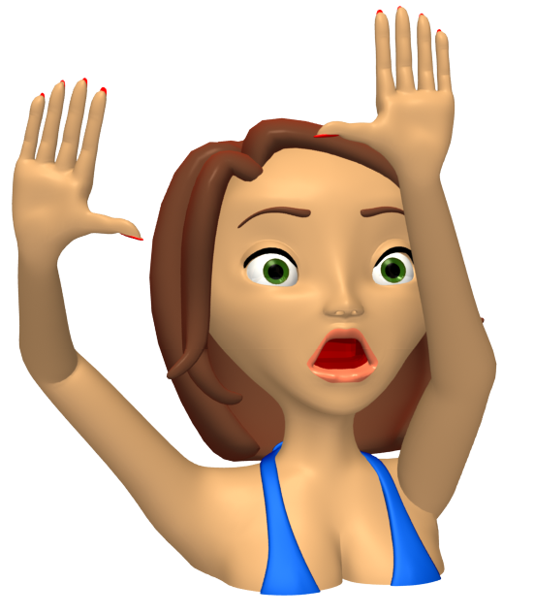
Author’s Purpose
Katina and her brother, Jess were playing with the water hose outside one day. Jess was hiding from Katina so she wouldn't squirt him with the water. The back door opened and Katina pointed the water hose toward the door. It was Mom and she was dripping wet!
What is the author’s purpose for writing this?
Inform
Persuade
Entertain

Slide 25
Oh no!
Try again please!

Slide 26
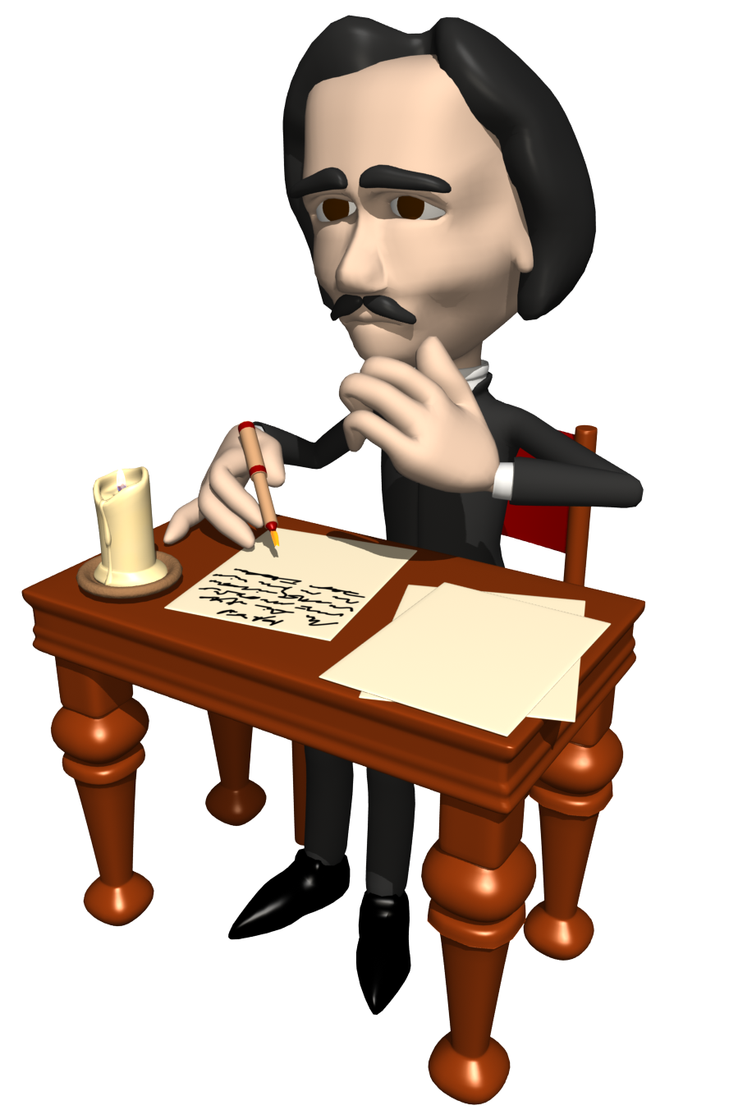
Great job! You finished the quiz! I can go back to writing.... Now, why was I writing this?

Slide 27

Thank you for purchasing this product! If you like what you see, consider leaving feedback. Visit my Website to see more of my products! I also have a great Author’s Purpose Power Point found here: http://www.teacherspayteachers.com/Product/Authors-Purpose-Powerpoint-Lesson
Are you on Facebook? If so, join Power Point Maniac’s Teaching Resources to get ideas, resources, and free stuff! www.facebook.com/powerpointmaniac

